Slide 1
Division of Child Care Town Hall
Professional Development and Training
August 8th, 2023

Slide 2
Required trainings and hours by provider type
Where can I find training?
How do I submit a Training Approval Request?
Above and Beyond – Scholarships & Credentials
Professional Development Plans & Supporting Staff
Notes:
We have a lot to cover today – but I will try to take time to hit on several points, and leave time for a few questions.
We will be covering the following topics today – generally – and I will leave lots of resources for you as well.
Note – I will not be able to answer a lot of individualized questions that require researching a particular circumstance, however I encourage you to e-mail us at DCCPDSTAFF@ky.gov so that we can assist. You can also contact TRIS.
The biggest thing to remember is that training dates and hire dates follow the employee – not just your center or home! We will discuss that in the upcoming content.

Slide 3
Required Trainings and Training Hours
Licensed Centers/Providers
7.5 hours additional training- 1st year
15 hours of training annually
CCAP Billing Training*
CPR & First Aid Certification**
Registered Providers (Relative Providers)
CPR & First Aid Certification**
Certified Family Child Care
1.5 hours additional training – 1st year
9 hours of training annually
CPR & First Aid Certification**
Orientation
Pediatric Abusive Head Trauma (PAHT)
CCAP Billing Training*
Notes:
Let’s start off – EVERYONE has to take PAHT. Within the first year of employment, and then every 5 years after that. The only difference is that certified providers can take that in their second year, along with additional trainings to total the 9 hours and along the training hours guidelines. But, it would need to completed in that second training hour year. Best practice is to complete the training right around Orientation time. It’s a critical, life-saving training.
Orientation HAS TO BE TAKEN by everyone in a Licensed center or a certified home. It is 6 hours. It must be taken within 90 days of a new staff being employed. If they are BRAND NEW to child care, this is a must. If they are coming from another center and have already taken it, that follows them. Be sure to check their Training Record for completion. The new version of Orientation includes a CPR and First Aid TRAINING component. It is not a certification, but fulfills the federal requirement to have training on the topic.
*CCAP Billing Training – Has to be taken by the registered provider, the owner of a certified home, and the licensee or director in a center. It does not need to be taken by all staff in the center – only the people who are the point of contact and completing the DCC-94E (this may include admins and assistant directors as well)
**CPR and First Aid Certification versus training – applicants for certified family homes and registered providers must have a valid/active CERTIFICATION – which means they have obtained skills testing and received a certification card from an approved agency (found on ECE-TRIS listing). All other employees and staff can have “training”. This is included in Orientation, OR they can take the free online module on ECE-TRIS to get the non-certified training hours. If you have an expired certification, this also fulfills the requirement.
This is a federal compliance issue. Licensed centers must have at least one certified CPR/FA person per age group (child/adult AND/OR Infant/Child/Pediatric) on site at all times.
Jessica Abner (Jessica.Abner@ky.gov) is going to share her e-mail address and also a listing of agencies that were approved for funding for CPR and First Aid Certifications if you need contacts to fulfil this for your staff.
Registered providers regulation is currently undergoing changes; this diagram reflects the proposed changes. Before the changes take effect, registered have to take 3 hours annually, and also Orientation within 90 days.
Additional hours can be obtained by trainings, conferences, online webinars, etc. You can find trainings that are already approved on the Calendar in ECE-TRIS, or you can find a training on your own to submit for approval.
Certified Family Child Care and Registered Providers have specialized technical assistance through the Family Child Care Network: https://www.fccnky.com/. Please reach out to them via their website, and the “Contact” tab if you have questions, concerns or need additional information about your business. They are a wealth of information and have specialist state-wide.

Slide 4
Where can I find training?
Define “Approved Training”
Calendar/Approved Trainings
Trainer Search
Notes:
What is an approved training? For a training to meet clock hour training requirements for licensed, certified, and registered Early Care and Education providers, Kentucky All STARS, the Commonwealth Child Care Credential, and the Kentucky Early Care and Education Trainer’s Credential it must be;
• Conducted by a Kentucky Early Care and Education Credentialed Trainer,
• Pre-approved by DCC at least 30 days prior to the training.
You can find previously approved trainings, OR you can submit your own trainings to be approved – which we will discuss further.
CALENDAR/APPROVED TRAININGS: This calendar on ECE-TRIS will display trainings that have been posted by Credentialed trainers or training agencies. You can search by delivery method (like face to face, webinar, independent study, etc.) Use multiple fields to search availability by subject area, format, etc. On the top of the calendar page there is also a link to DCC Approved CPR and First Organizations and Free Online Trainings Available on ECE-TRIS.
TRAINER SEARCH: use this feature on ECE-TRIS to look for trainers who you can contact to schedule trainings. This allows you to search for Orientation, PAHT, and other content areas.
We are going to take a quick look at what each of those look like when you navigate to them on the following slides.
***LINK TO TIP SHEET: https://ece.trc.eku.edu/ece/resources/files/247 ***

Slide 5
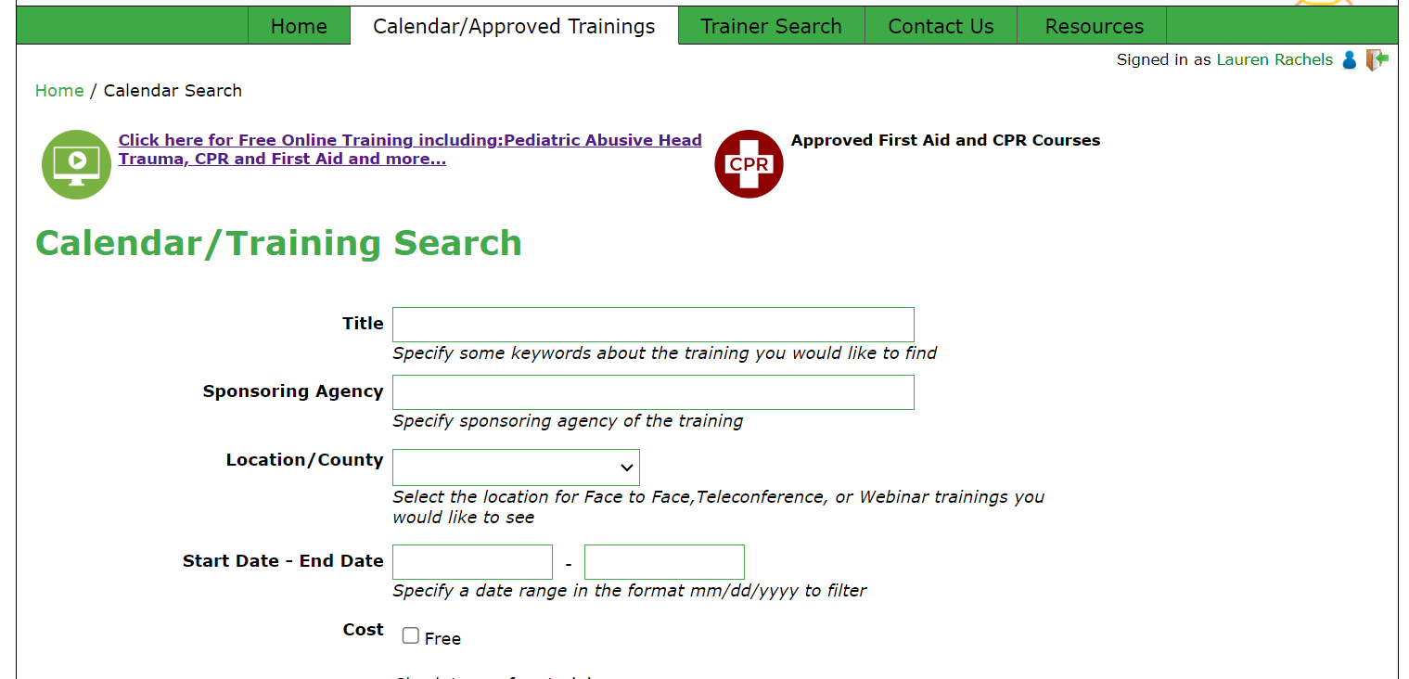
Notes:
Where are the Calendar and Trainer Search options?
When you log in to ECE-TRIS, on the top green tool bar, there are tabs labeled “Calendar/Approved Trainings” and “Trainer Search”.
Under Calendar/Approved Trainings – you will see the screen that is pictured.
This is also where you can access the listing of free trainings, Pediatric Abusive Head Trauma, and the non-certified CPR/First Aid training. You’ll also see the list of Approved First Aid and CPR Courses; this beings up a PDF of approved CERTIFICATION agencies and options for certifications.
There are so many options and filters as you scroll down to locate trainings that fit your needs. Less is more when searching for trainings!
-Once you find a training you’d like to take – be sure to check the title! Make sure the title that is approved matches the exact title of the course you will be taking, and that the hours also match.
-Pay attention to the training date range. This will indicate when you need to have credit completed by (this may be pre-dated, or post-dated)
-The calendar results will also display a credit process for how credit will be issued in TRIS. In some cases, you MUST self-report. There may also be a date range that you can expect the agency to report to ECE-TRIS. This is important to pay attention to, if you’d like for the credit to display on your training record. In most cases, if your credit is not displaying on your record, you need to contact the AGENCY/COMPANY that did the training, first.
-You cannot take the same online courses (including Orientation) within a 5 year timeframe to count for licensing clock hours/credit. This is for any asynchronous training (meaning there is no “live” component). The only exception is if it’s part of a disciplinary action submitted by a state agency or the employer.

Slide 6
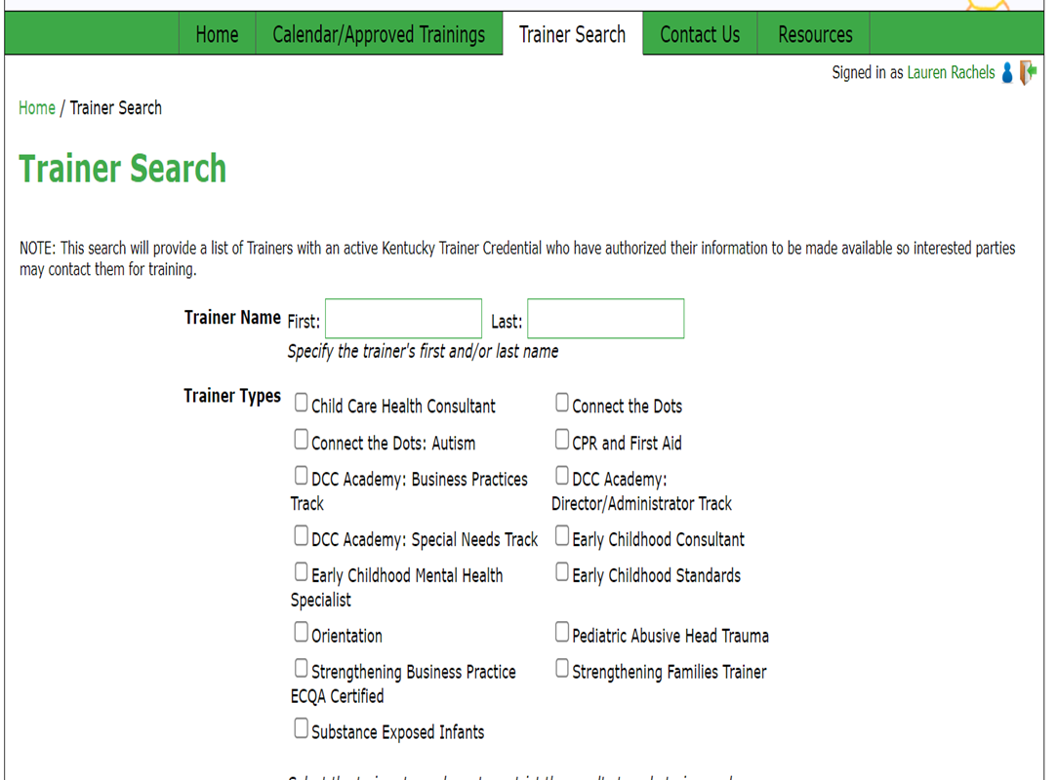
Notes:
Under Trainer Search, you will see options to search by trainer types, region, etc.

Slide 7
Training Approval Requests
Search the Calendar/Approved Trainings Area FIRST to see if the training is already approved
Once you are logged into ECE-TRIS, select “Training Requests”
Complete all details in the Request area and follow the prompts for uploads and information.
Notes:
Training events/sessions must be approved AT LEAST 30 days prior to the event.
For additional questions or support, contact ECE-TRIS directly. They may also contact you if additional information is needed to complete the request.
*** LINK TO TRIS RESOURCE: https://ece.trc.eku.edu/ece/resources/files/301 ***

Slide 8
Scholarships and Credentials
Commonwealth Child Care Credential
Child Development Associate
Infant and Toddler Credential
School Aged Youth Development Credential
Director’s Credential
Associate’s Degree
Trainer’s Credential
Bachelor’s Degree
Master’s Degree
Early Childhood Development Scholarships:
Non-College Scholarship (CCCC and CDA)
Kentucky Higher Education Assistance Authority (KHEAA) Scholarships
Milestone Achievement Awards and Related Education Awards
CDA Mini-Grants
Accreditation Grants
Apprenticeships
Digital Badging (coming soon!) & awards
Notes:
Please reach out to your Child Care Aware Professional development Coach > https://www.childcareawareky.org/support/professional-development/
NOTE: Please, please make sure that providers are recording their degrees, credentials (like CDA’s) and certificates in ECE-TRIS! This is the only way to ensure future funding for grant and scholarships; this is the way we ensure we can continue this.

Slide 9
Professional Development Plans
Required per regulation
Can include minimum requirements to comply with regulation
Can include plans for training and certifications beyond regulation requirements (best practice)
Notes:
Director’s/Admin roles and requirements:
Required per regulation (licensure regulation: 2:090) to have a “written annual plan for child care staff professional development”
Having this plan will also assist with the regulatory requirement to have an annual written performance evaluation (2:090 Section 10 (J))
Where to locate a sample Professional Development Plan: Child Care Aware of Kentucky > Tips and Tools > Health & Safety > Staffing > Annual Professional Development Plan https://www.childcareawareky.org/wp-content/uploads/2022/07/Revised-PD-Plan-full_2022.pdf

Slide 10
Supporting Staff
Professional Development leads to…
Increased Job Satisfaction
Increased Employee Recruitment & Retention
Increased Quality Rating
Less missed days of work due to burn out
Motivation in Staff to Learn and Perform
Increased communication between parents, directors & staff
Notes:
We are in a really hard time right now with recruitment and retention of staff, and some days just keeping your doors open. DCC is aware and your concerns are valid.
While in some ways it seems counterintuitive to have staff out of the classroom for professional development, job satisfaction and employee retention go UP with solid professional development plans and opportunities in place. Professional Development is a skill builder, a confidence builder, and a morale builder. When teachers have professional development under their belt, they feel more prepared to handle stressful situations in the classroom. The have background knowledge to fall back and rely on.
Examine ways you, as a center, can support staff (or yourself) to reach those goals. Allow time out of the classrooms to attend a training. Schedule super Saturdays, or utilize federal holidays for paid training (with lunch!) for your staff once a year. Increase compensation when you can for teacher’s hourly wages, paid time off, etc. based on completed professional development goals, like obtaining a new credential. (For example, once a teacher obtains their CDA or above, incentivize them with an additional day of paid leave time, per year. Or, increase their hourly wage once they reach a certain PD goal, like a Bachelor’s degree. You can even give them a one-time accomplishment incentive, like a gift card or an afternoon off.)
Talk with your Professional Development Coach with Child Care Aware to learn about opportunities that DCC has for grants and scholarships! They are out there and ready to be used for staff who want to earn and learn more!

Slide 11
Reminders about Training and Hire Dates
Do NOT complete trainings prior to an eligible determination in KARES!
Trainings will count for completion, but staff will not receive clock hours for annual regulatory requirements.
KARES and ECE-TRIS share reports for hire dates, determination dates, employment history, etc.
Personal data needs to be accurate ACROSS platforms!
Incorrect information in either can cause delays and inaccurate reporting.
Staff under age 18 cannot go in KARES.
As much as possible, avoid “brand new to child care” hires with a short second year (June).
Notes:
How to Calculate Hours for New Staff> https://ece.trc.eku.edu/ece/resources/files/128
Understanding Hire Dates on TRIS Records and Reports> https://ece.trc.eku.edu/ece/resources/files/414
Under 18 Tip Sheet> https://www.childcareawareky.org/wp-content/uploads/2022/01/Tip-Sheet-for-Hiring-Staff-Under-Age-18-9.2021-5.pdf

Slide 12
Tip Sheet: How to Find Approved Training in ECE-TRIS
Tip Sheet: How to Submit a Training Approval Request in ECE-TRIS
Child Care Aware: Professional Development Site & Locating Your Coach
CCA Sample Professional Development Plan
Tip Sheet: How to Calculate Hours for New Staff
Tip Sheet: Understanding Hire Dates on Records & Reports in ECE-TRIS
Tip Sheet: Hiring Staff & Higher Ed Students Under 18 Years Old
Kentucky Administrative Regulations for Child Care - All Topics
Lots of Links!

Slide 13
Questions?
Department for Community Based Services
Division of Child Care
Professional Development Section
DCCPDStaff@ky.gov

